Slide 1
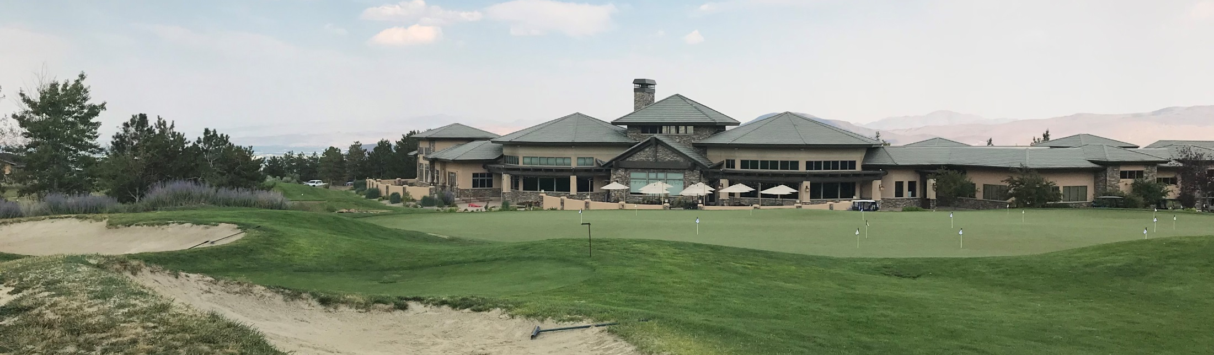
WSUP18-0020 & WADMIN18-0015
The Club at ArrowCreek
Washoe County Board of Adjustment
April 4, 2019

Slide 2
Request
The request is for:
A special use permit (SUP) to allow for the use of Conventions and Meeting Facilities as part of the expansion of the Club at ArrowCreek and for grading - to excavate more than 1,000 cubic yards of material and for a driveway area that will exceed more than 30% slope; and
2. An Administrative permit to allow for the use of Indoor Sports & Recreation

Slide 3
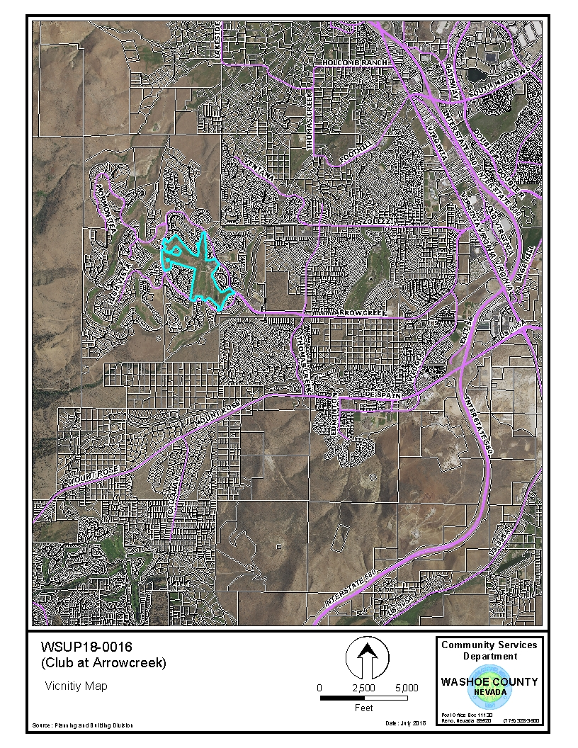

Slide 4
Background
The Club at ArrowCreek is a member only facility with two 18-hole golf courses and associated facilities
A Special Use Permit (SUP) was approve on September 6, 2018 by the Board of Adjustment for the expansion of outdoor sports and recreation uses, including a pool and pool house and grading on the property

Slide 5
Background
On March 12, 2019 the County Commissioners approved a zoned change from High Density Rural (HDR) on 140 acres and Low Density Suburban (LDS) on 8.9 acres to Park and Recreation (PR) on 149 acres
The change of zoning to PR now allows for the uses being requested

Slide 6
Background
Per WCC Table of Uses for the regulatory zoning of Parks and Recreation (PR) Conventions and Meeting Facilities is allowed with a Special Use permit, which includes weddings and special events
Indoor Sports & Recreation is allowed with a Administrative permit, which will include the proposed pickleball court

Slide 7
Background
Per WCC Article 438 a Special Use permit is required for grading of more than 1,000 cubic yards and for a driveway or road that traverses a slope of 30% or greater
The applicant will be grading the project area to accommodate for the new facilities and developing a parking area with a driveway with a slope of 30% or greater

Slide 8
Analysis
The applicant is proposing to expand the existing club by 19,000 sq. ft. to add new uses to the site, including additional kitchen and dining area space for weddings and events.
A 7,000 sq. ft. pickle ball court to be constructed and located in the southeast area of the existing parking lot
The applicant indicates that the new recreational uses will enhance the facility and make the Club more versatile and attractive to existing members and potentially to new members.

Slide 9
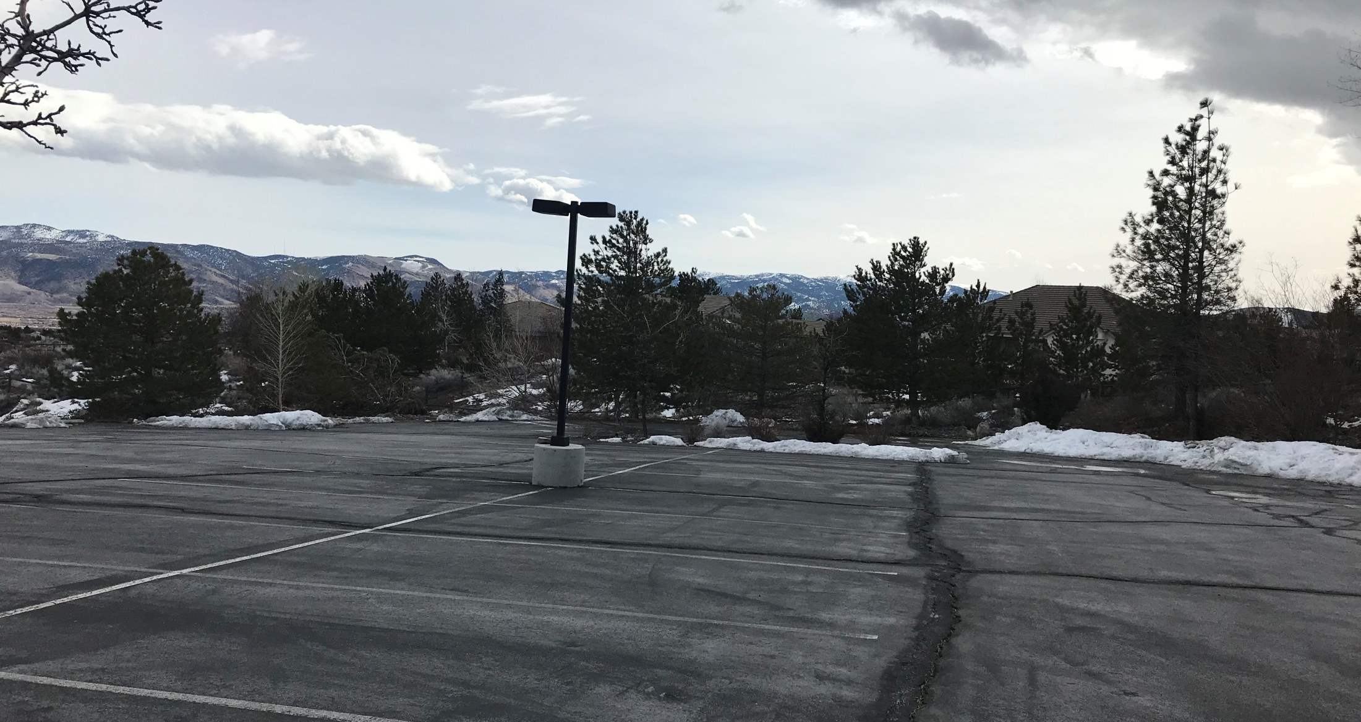
Location of Pickle Ball Court

Slide 10
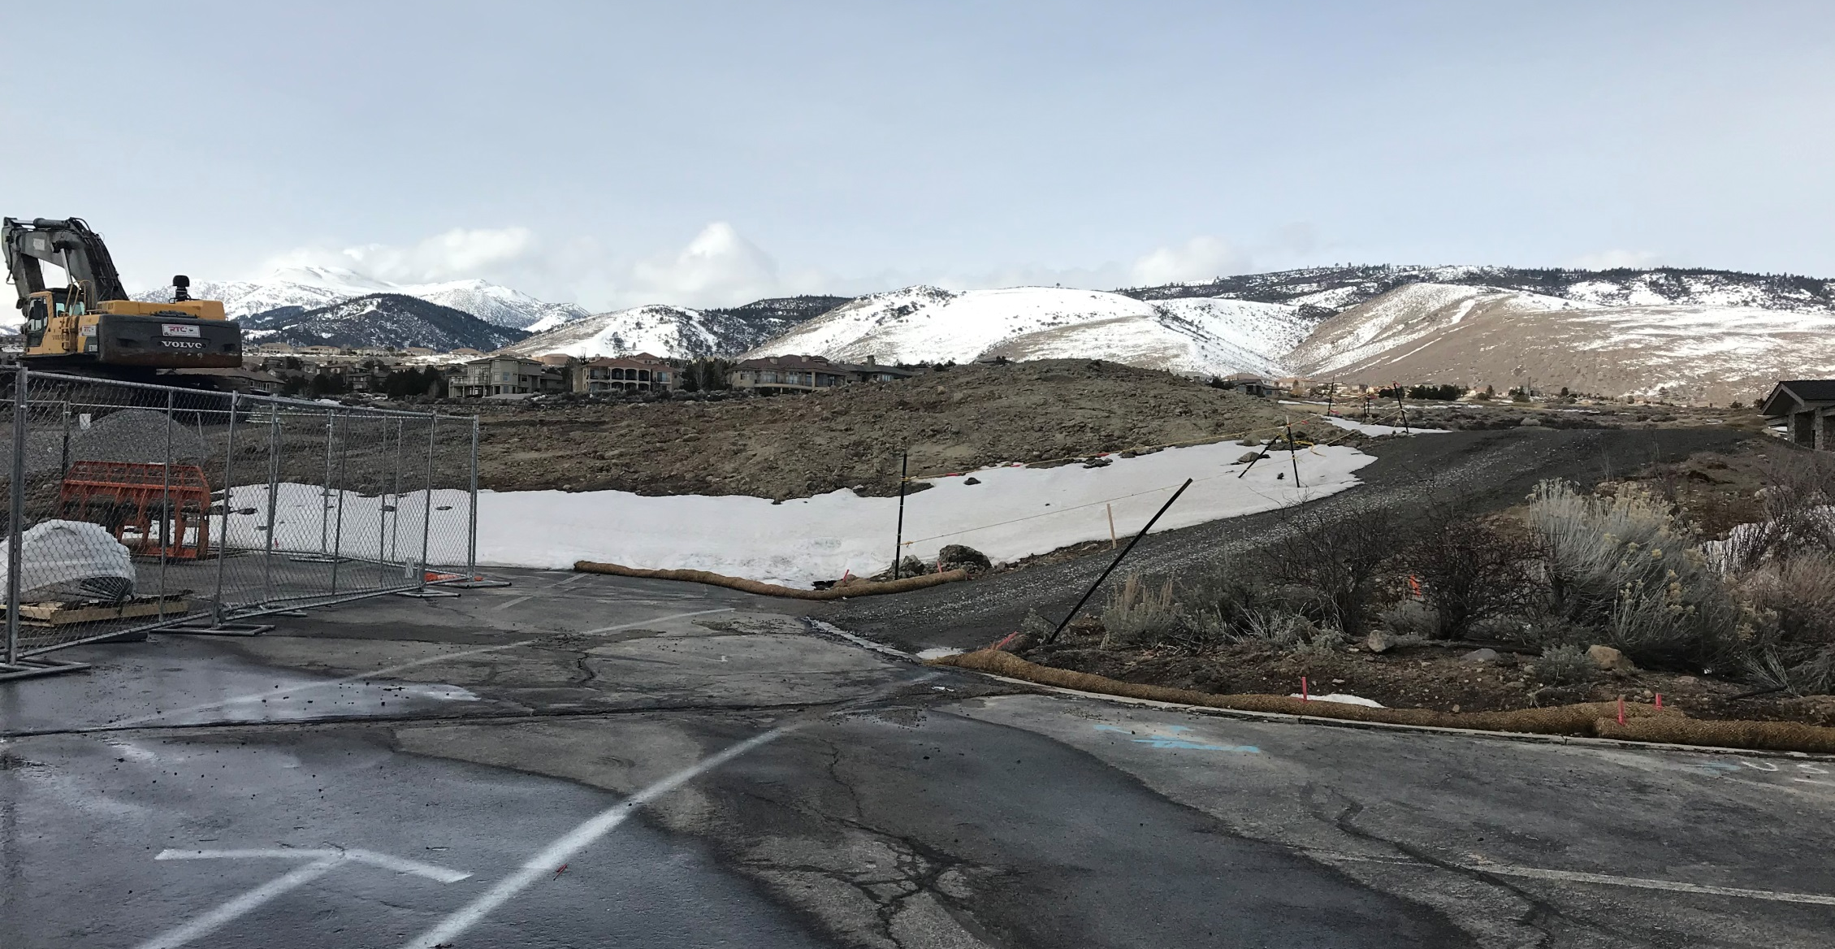
Location of Driveway

Slide 11
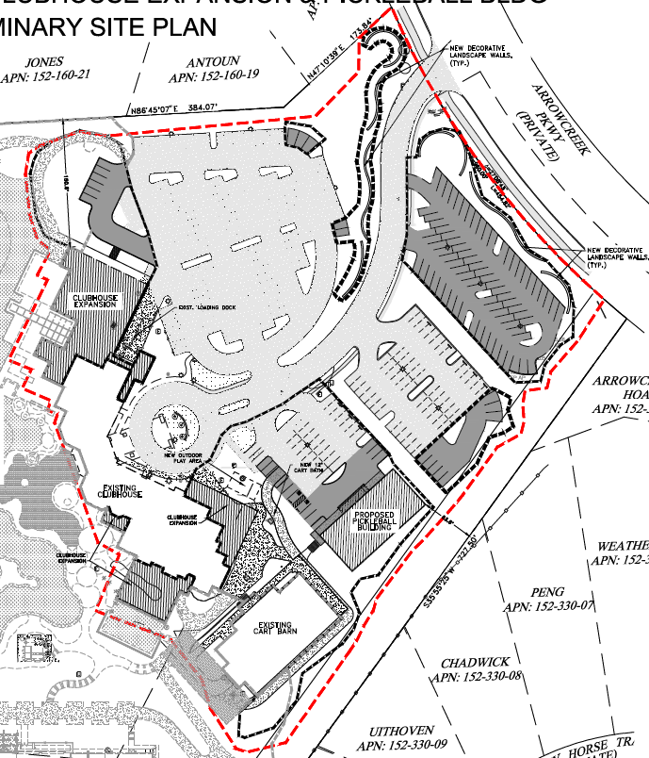

Slide 12
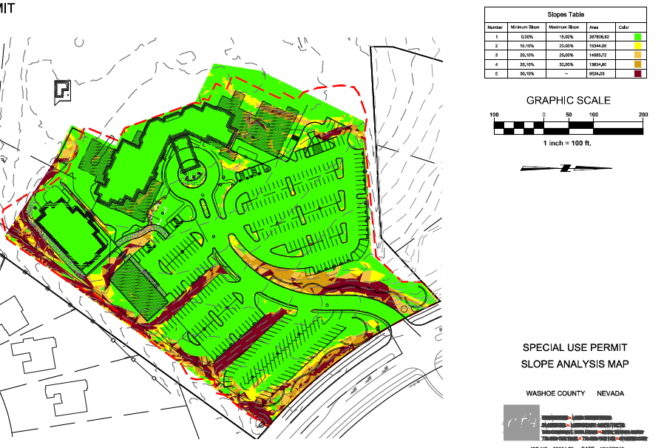
Driveway area
New Buildings
Pickleball Court

Slide 13
Analysis
The applicant indicates that no improvements are needed to the roadways or parking area- more parking for golf carts, is proposed.
The site has significant landscaping and meets code, however landscaping will be added as needed around the new recreational facilities.
The applicant has worked with neighboring parcels to lessen any impacts with surrounding residential neighbors including blocking views, noise, and lighting.

Slide 14
Public Notice & CAB
Notices were sent to 294 parcels
The South Truckee Meadows/Washoe Valley CAB reviewed the application on January 3, 2019 and recommended to approve the applications.

Slide 15
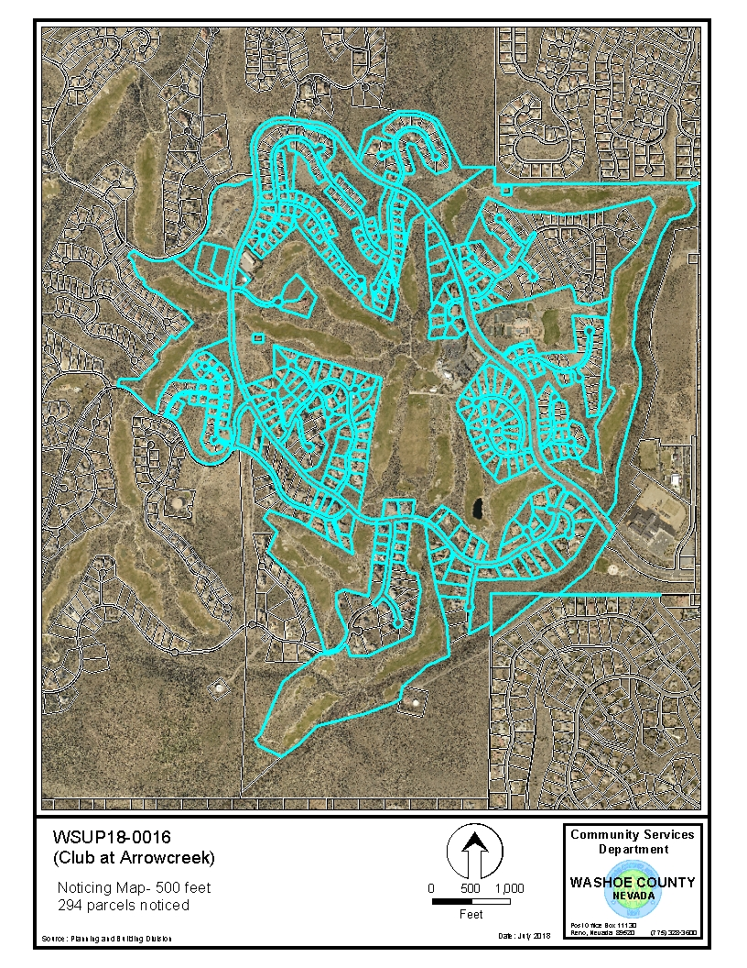

Slide 16
Reviewing Agencies
The reviewing agencies had no issues with the application and conditions are included in your staff report.

Slide 17
Findings
Staff is able to make all the required findings, as detailed in the staff report on Page 13-14

Slide 18
Special Use Motion
I move that, after giving reasoned consideration to the information contained in the staff report and information received during the public hearing, the Washoe County Board of Adjustment approve, with the conditions included as Exhibit A to this matter, Special Use Permit Case Number WSUP18-0020 for Lucky Star Golf, LLC, having made all five findings in accordance with Washoe County Code Section 110.810.30

Slide 19
Administrative Permit Motion
I move that, after giving reasoned consideration to the information contained in the staff report and information received during the public hearing, the Board of Adjustment approve with the conditions included as Exhibit A to this matter, Administrative Permit Case Number WADMIN18-0015 for Lucky Star Golf, LLC, having made the four findings in accordance with Washoe County Code Section 110.808.25

